Slide 1





Cooperative Education
PCR SYSTEM
Process Change Report System

Slide 2
Agenda
Work & Responsibility and Organization
01
02
Action Plan
03
Introduction & Process
04
Conclusion
05
Skill & Experience

Slide 3
Our Team
Kittiya YangSo
Kanyarat Rodtong
Supatchai Kamaporn
Department : HR
Section : HRIS
Department : HR
Section : HRIS
Department : HR
Section : HRIS

Slide 4


Organization
President
Vice President
AGM
Manager
Payroll
RC
SD
AR & AD
SMD
HRIS
SD
Temporary
Specialist
Staff
Officer
Trainee

Slide 5



Our Team
Kantima Hattharak
Thanakorn Nawweng
Seree Jamnongtham
Department : HR
Section : HRIS
Department : HR
Section : HRIS
Department : HR
Section : HRIS

Slide 6
Work & Responsibility

Slide 7

Work & Responsibility(Support)
1
Development Process Change Report System (PCR)
2
Check finger scan (Support)
3
Support MHRD exam (Support)
3

Slide 8

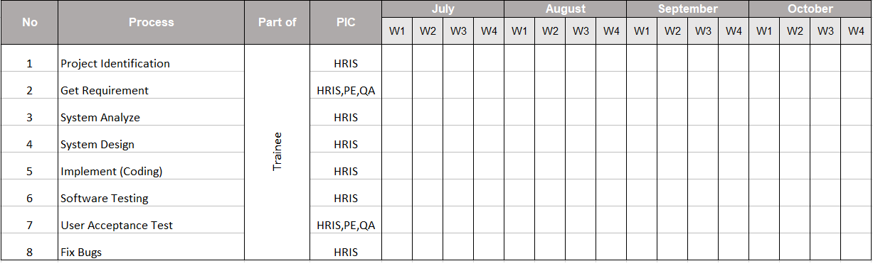
Action Plan
Plan
Process
Analyze System
Design
Get requirements
Analyze requirements
Design mock up of system
Confirm mock up with user
AUG
OCT
JUL
Analyze System
SEP
Implements
Analyze requirements
Design diagram
Confirm requirements
Coding PCR system in phase 1
Test System & Demo System
Presentation PCR System

Slide 9

What is PCR System ?
Process Change Report (PCR) system which records changes.
The work processes of each department within the company and information
management.

Slide 10













What Problems ?
01
ปัญหาเกี่ยวกับกระบวนในการจัดเก็บข้อมูลของเอกสาร PCR
02
ปัญหาเกี่ยวกับการออกเอกสาร PCR ที่ยุ่งยาก และใช้เวลานาน
03
ปัญหาเกี่ยวการใช้ทรัพยากรที่มีจำนวนมาก เช่น กระดาษ เป็นต้น

Slide 11
Work & Responsibility
Analyze PCR System
Storage
Access
Design : PCR System
Storage
Access
Manage role all
Implement : PCR System
Edit PCR form
Approve User Register
Manage role all
Kittiya Yangso

Slide 12
Work & Responsibility
Analyze PCR System
Form
Design : PCR System
PCR ,QAP, BKD Form
Annual Plan Form
Manage role QA
Implement : PCR System
Create PCR form
Manage role QA
Kanyarat Rodtong
- Approve departments
- setting role QA
- PCR List

Slide 13
Work & Responsibility
Analyze PCR System
- Work Flow
Design : PCR System
Work Flow
Cancel PCR form
Implements : PCR System
Cancel PCR form
View PCR form
Manage Annual Plan
Approver Department
Supatchai Kamaporn
Manage Annual Plan
View PCR form

Slide 14
Introduction & Process

Slide 15
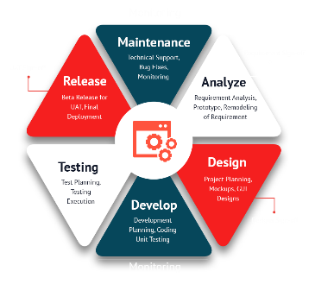








Tool
SDLC is a process followed for a software project, within a software organization.
Software Development
Life Cycle (SDLC)
Notepad ++
Draw.io
Microsoft PowerPoint
Microsoft Word
phpMyAdmin
language

Slide 16
Analyze System
01
02
03
FORM
WORK FLOW
STORAGE & ACCESS

Slide 17
Analyze System
WORKFLOW
Analyze Workflow
Old Work Flow
People involved in the work Flow
01
Old Work Flow
02
People involved in the work Flow
03
Problems Work Flow

Slide 18
Old Work Flow
Plan
Result
Input change point
details and schedule
Input Evaluation result
Check
PE
PE
Check
Approve
Approve
Approve
PD
PD
Approve
No
If rank => C2
Check
Yes
Input Planning review result
QAP
QAC
Approve 1
Input cleanliness check
requirement
BKD
Approve 2
Check
Acknowledge and distribute
Approve 1
QAC
Alert to owner and share
to concern person
Approve 2
Alert to owner + share
to concern person
Process change
request finished

Slide 19









Analyze System
WORK FLOW
จากการวิเคราะห์ Old Work Flow พบปัญหาคือ
ปัญหาในการแจ้งเตือนการอนุมัติซึ่งก็ให้เกิดการล้าช้าในการเปลี่ยนแปลงกระบวนการทำงาน
ปัญหาในการใช้งานที่ยังไม่ครอบคุมต่อการเปลี่ยนแปลงกระบวนการทำงานจากผู้ใช้งานในส่วนอื่นๆ
01
Old Work Flow
Department Other
Department Other
02
People involved in the work Flow
03
Problems Work Flow
PE,QA
PCR

Slide 20
New Work Flow
Plan
Result
Input change point
details and schedule
Input Evaluation result
And selected approver
Creator
Creator
Reject
Reject
Creator Select Checker
Maximum 5 checker
PE
Creator Select Checker
Maximum 5 checker
Check
Approver
Department
PE
Check
Approver
Department
Reject
Approve
Reject
Approve 1
Reject
Acknowledge Approver
Approve
PD
No
PD
Reject
Approve 2
Acknowledge Approver
If rank => C2
โดยทุกๆการอนุมัติจะมีการแจ้งเตือนส่งไปหาคนถัดไปเสมอ
Yes
Input Planning review result
QAP
Reject
QAC
Approve
Input cleanliness check
requirement
BKD
Setting By QA Admin
Reject
Approve
QAC
Setting By QA Admin
Alert to owner and share
to concern person
Alert to owner + share
to concern person
Process change
request finished

Slide 21
New Work Flow
Plan
Result
Input change point
details and schedule
Input Evaluation result
And selected approver
Creator
Creator
Reject
Reject
Check
Check
Approver
Department
Reject
Approver
Department
Approve
Reject
Approve 1
Reject
Approve
No
Reject
Approve 2
Acknowledge Approver
Acknowledge Approver
If rank => C2
Yes
Input Planning review result
QAP
Reject
QAC
Approve
Input cleanliness check
requirement
BKD
Reject
Approve
QAC
Alert to owner and share
to concern person
Alert to owner + share
to concern person
Process change
request finished

Slide 22
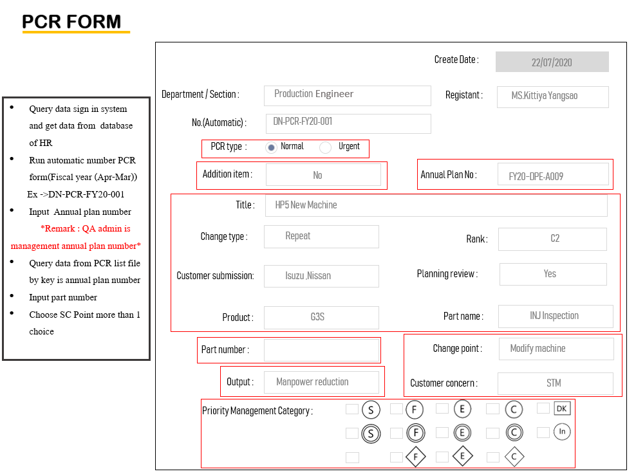
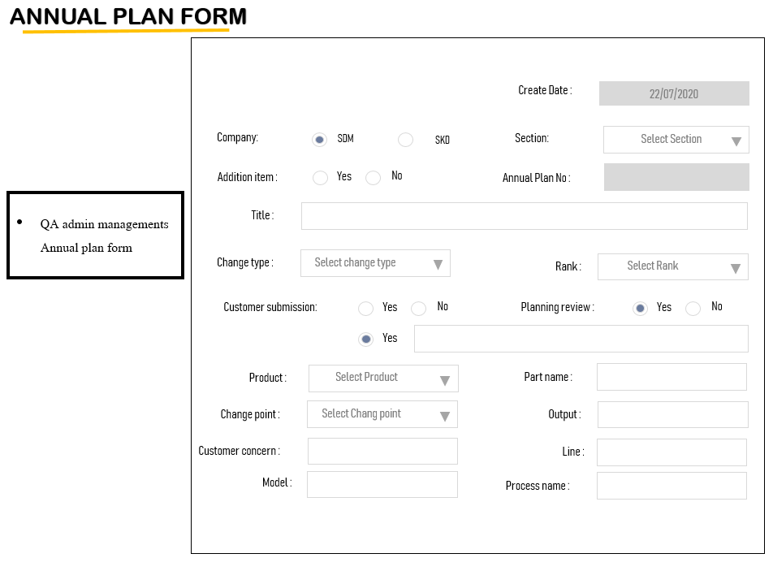
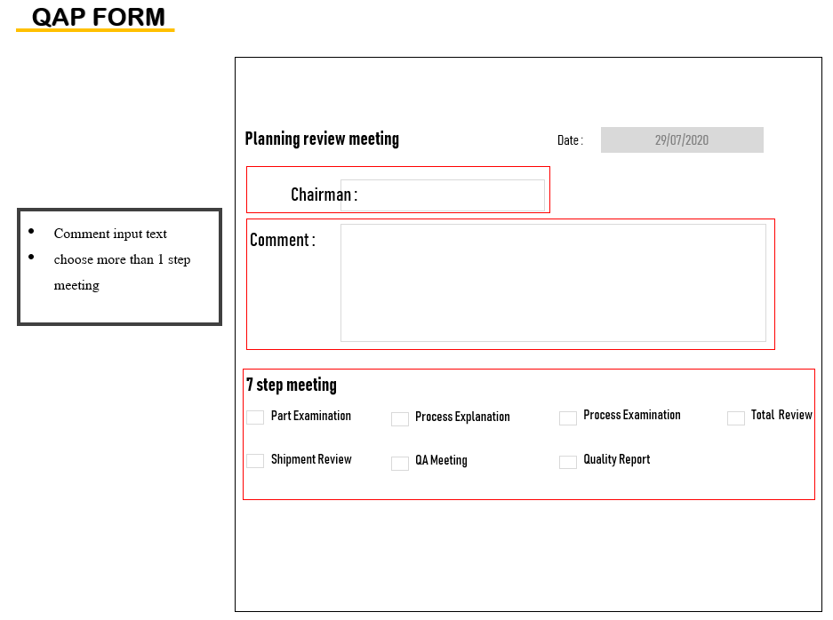
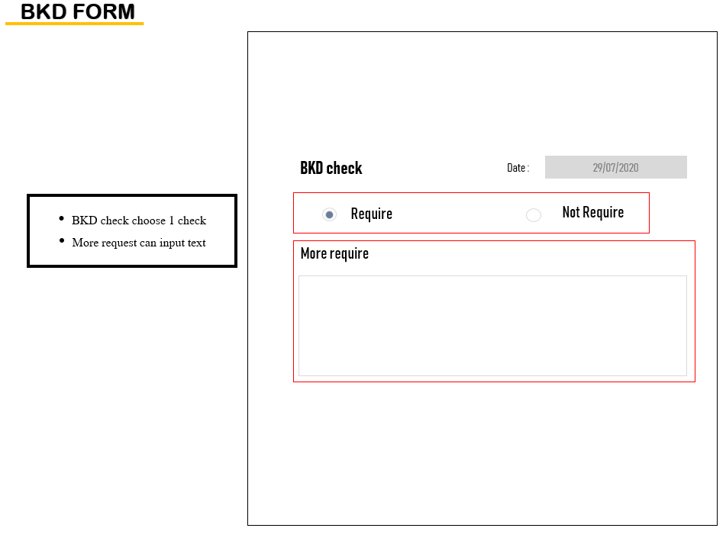
Analyze System
FORM

Slide 23
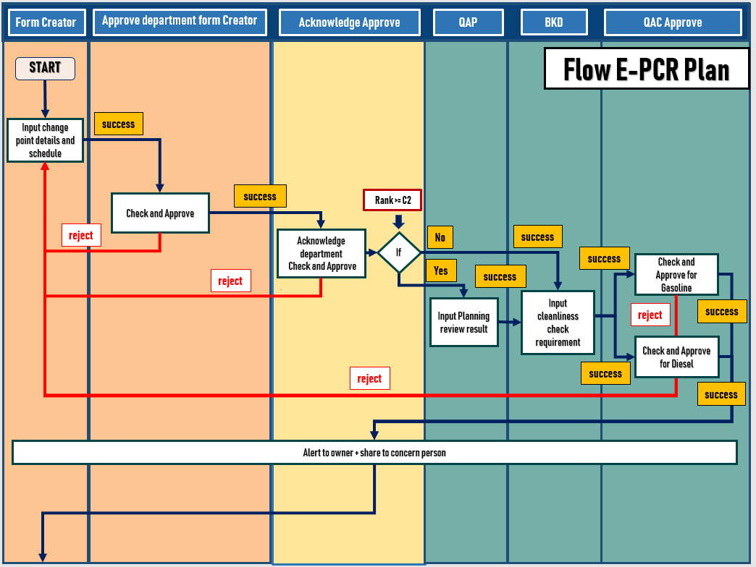
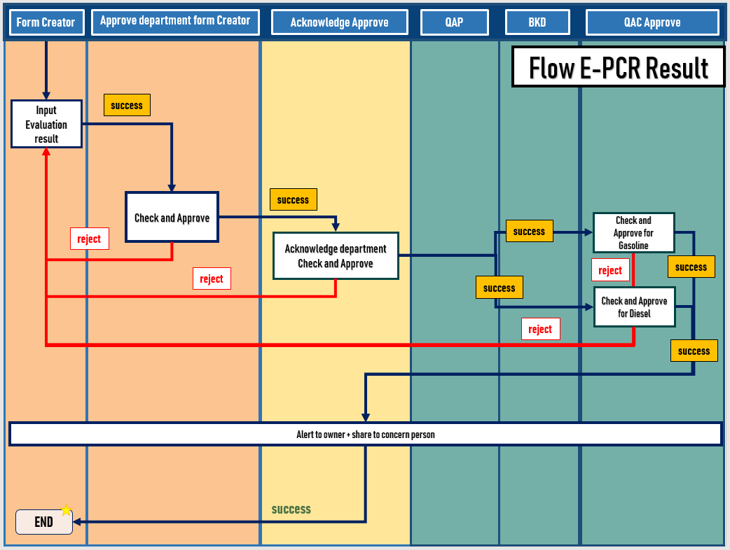
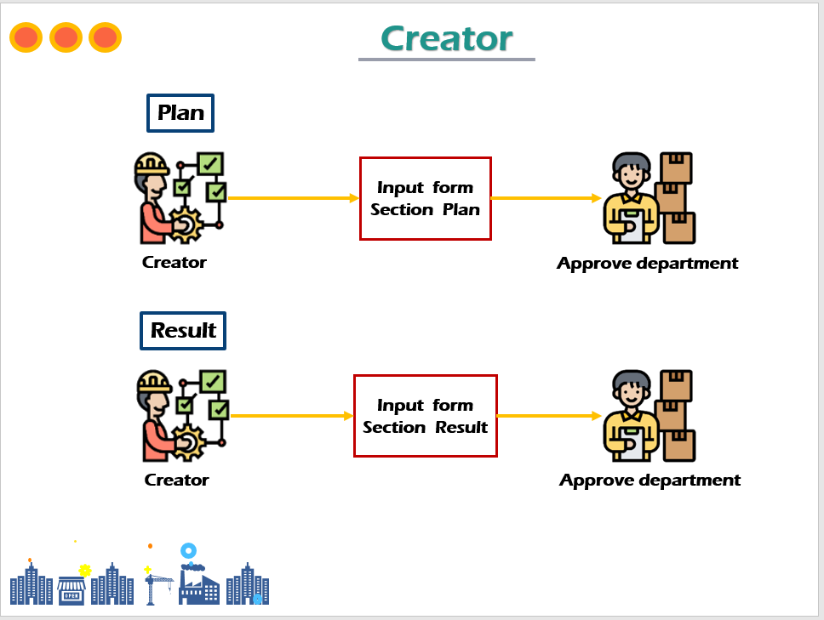
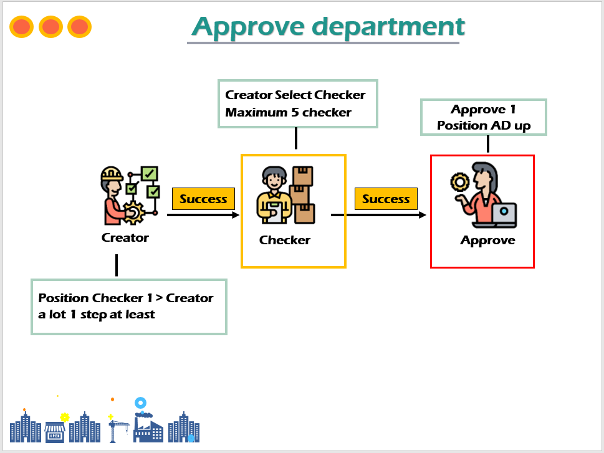
Analyze System
WORK FLOW

Slide 24
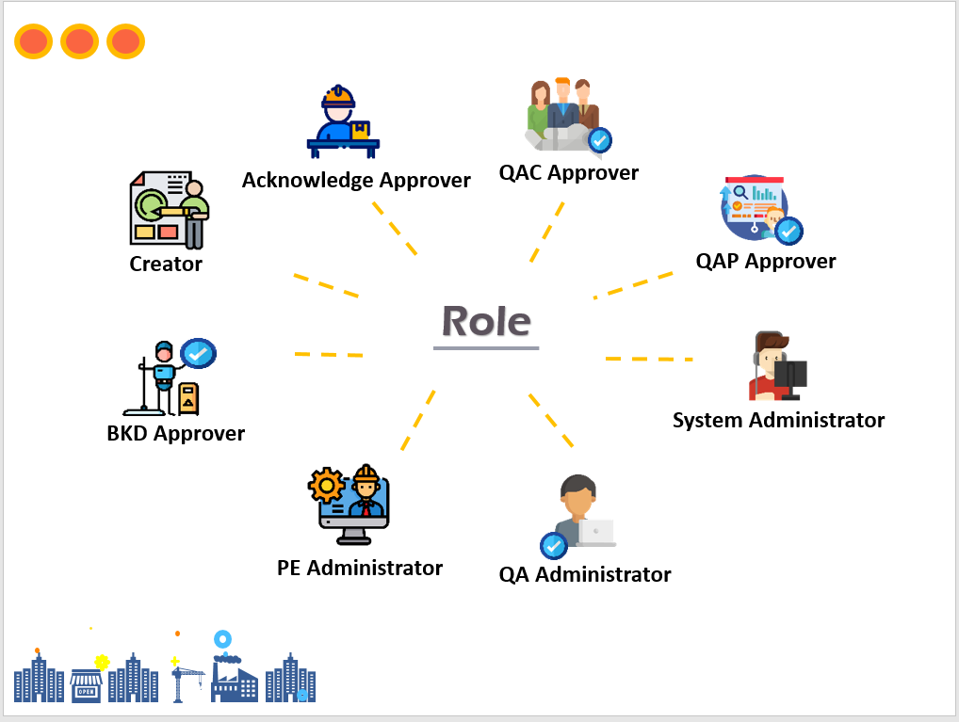
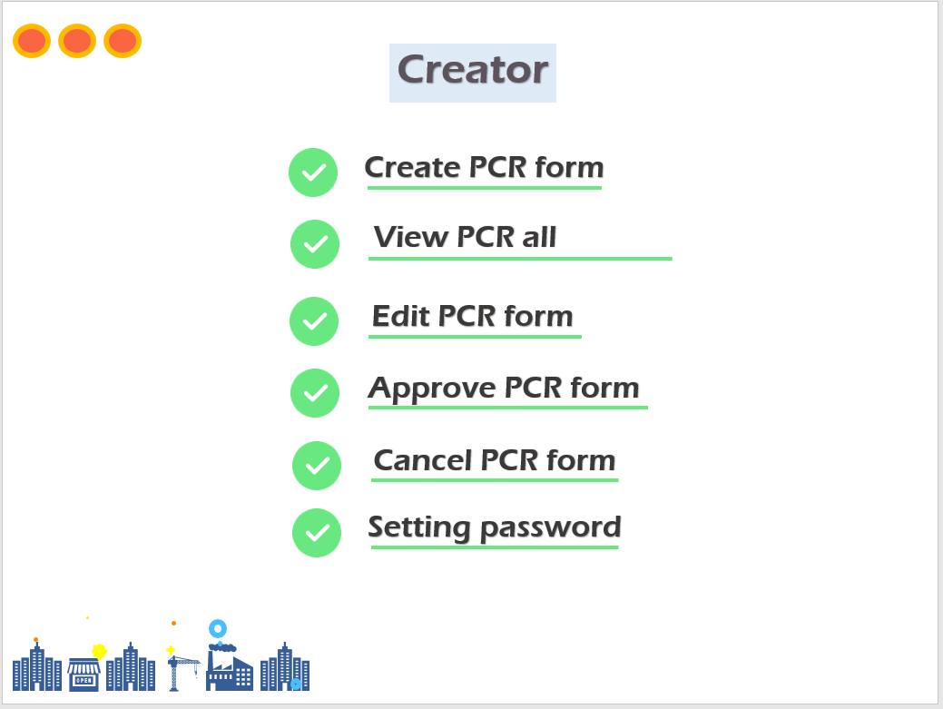
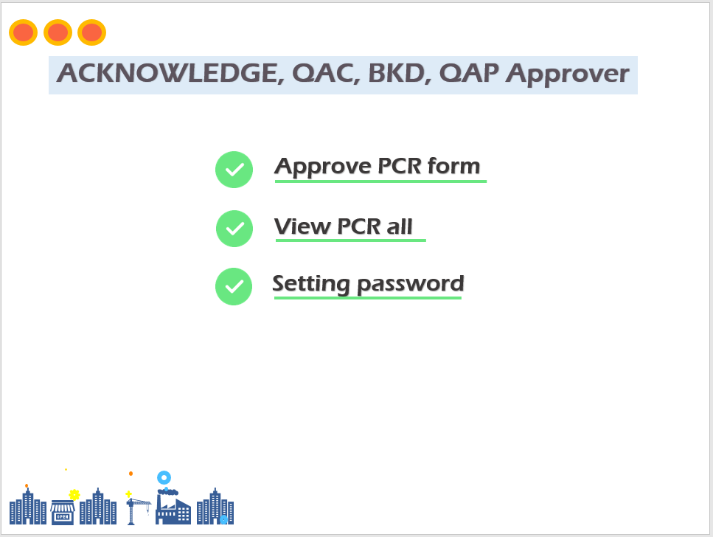
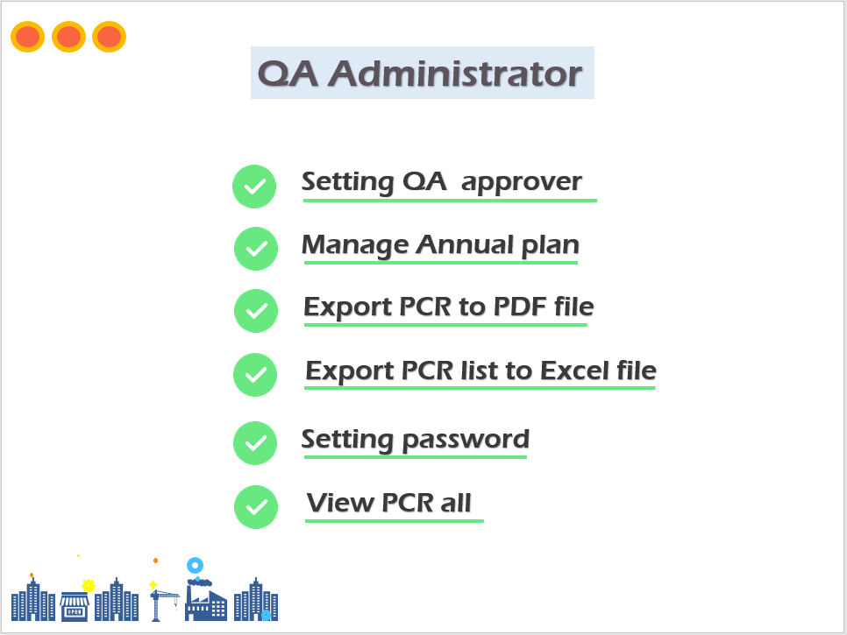
Analyze System
ROLE SYSTEM

Slide 25
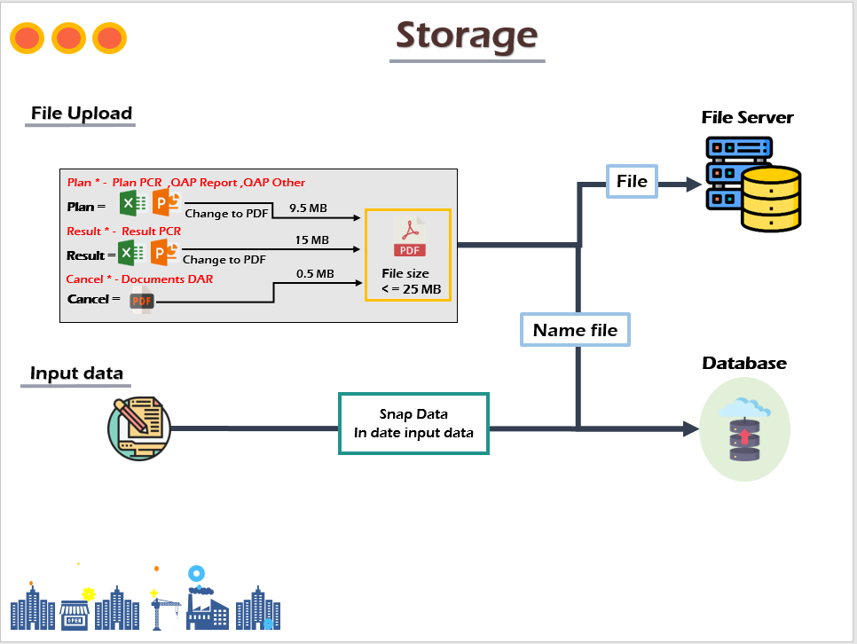
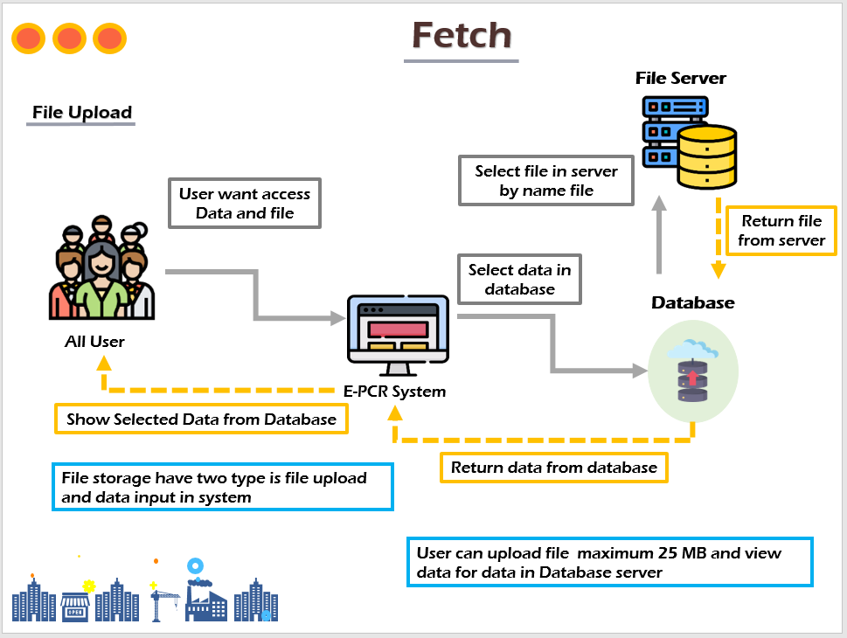
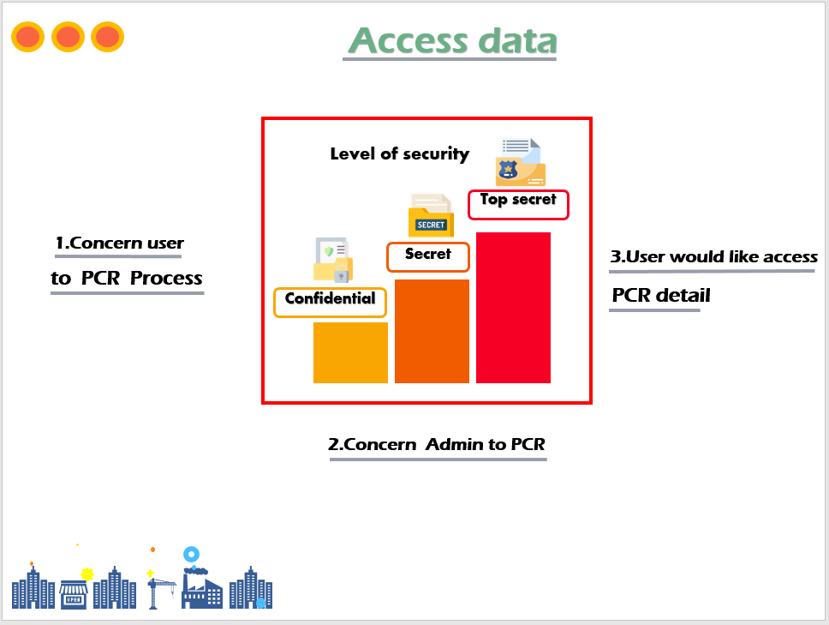
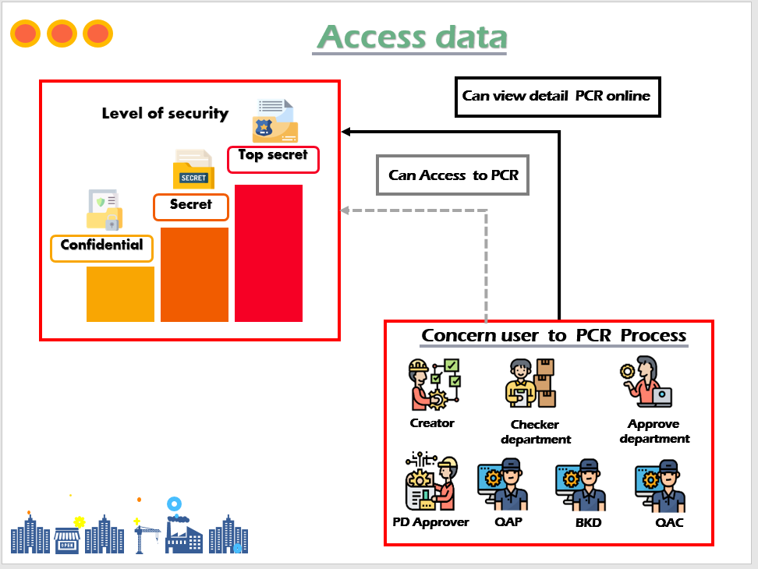
Analyze System
STORAGE & ACCESS

Slide 26
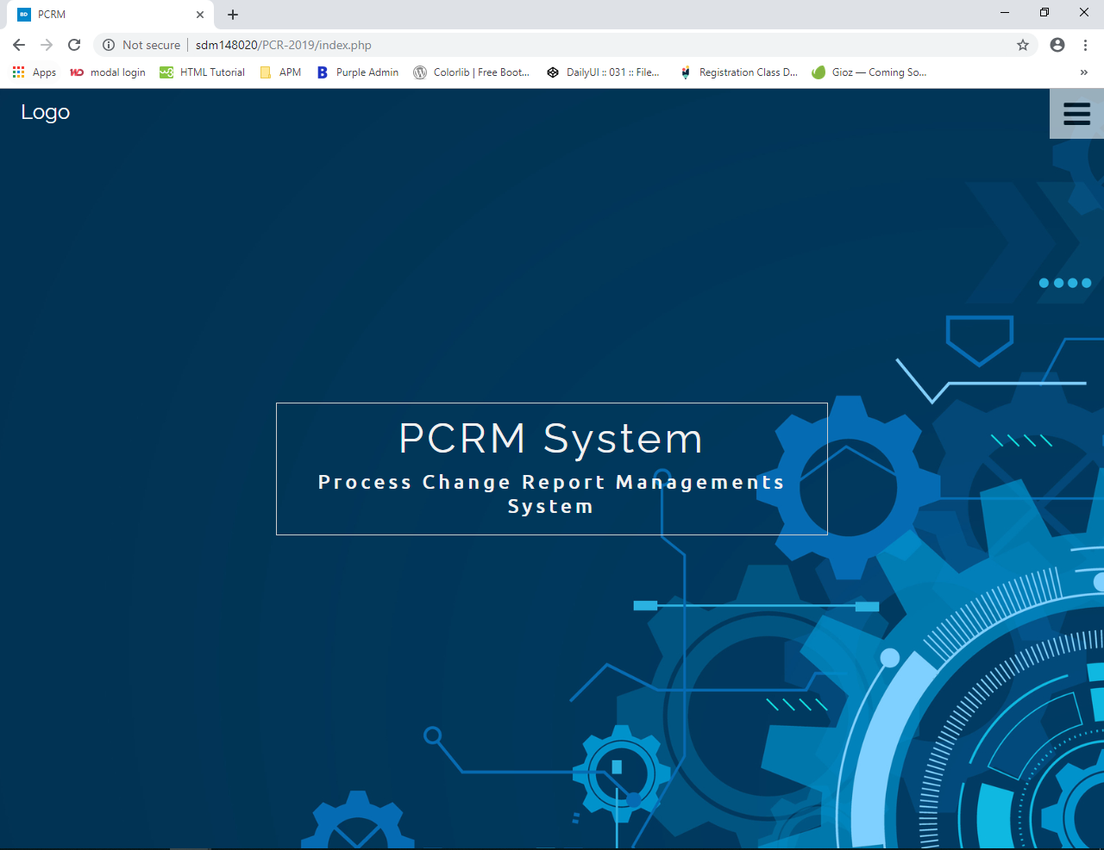
SYSTEM USER INTERFACE: PCR SYSTEM
INTERFACE:HOME

Slide 27
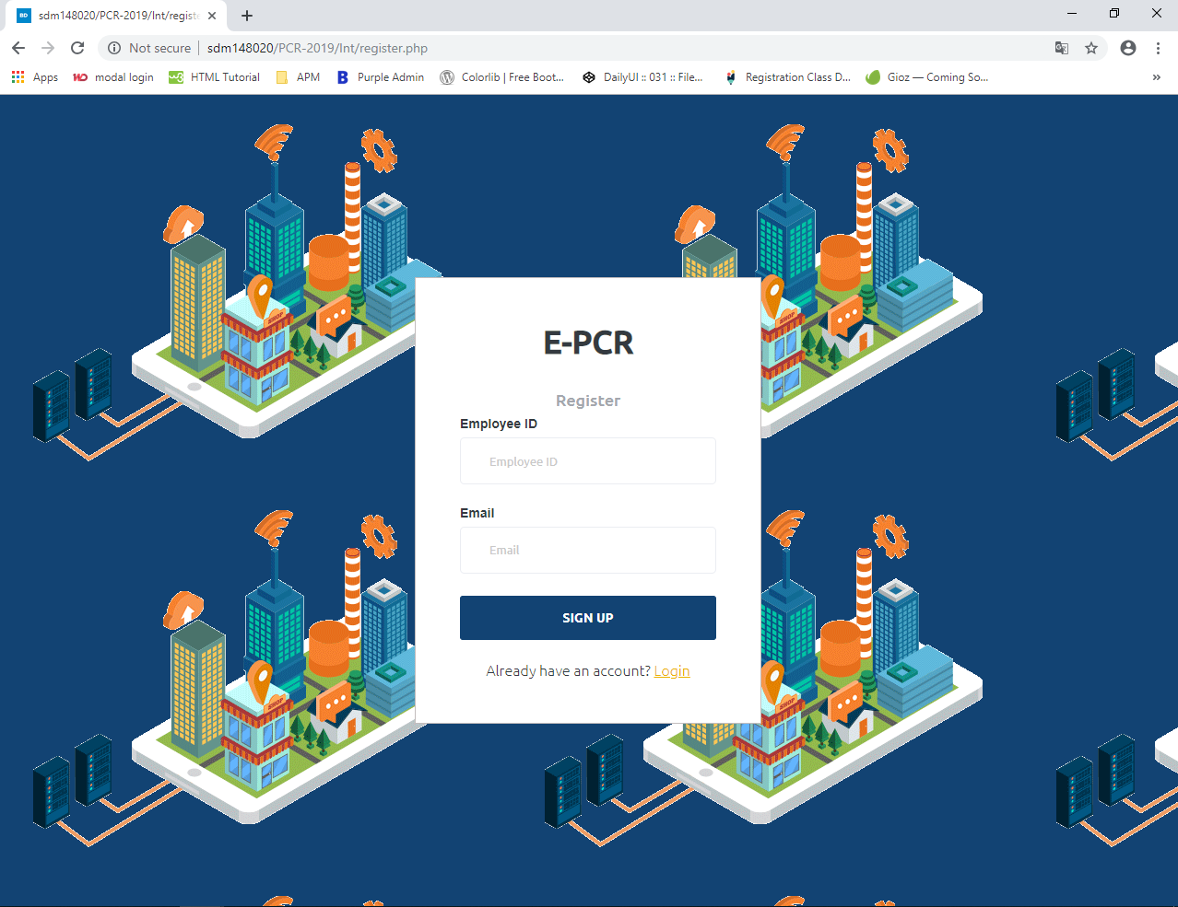
SYSTEM USER INTERFACE: PCR SYSTEM
INTERFACE:REGISTER

Slide 28
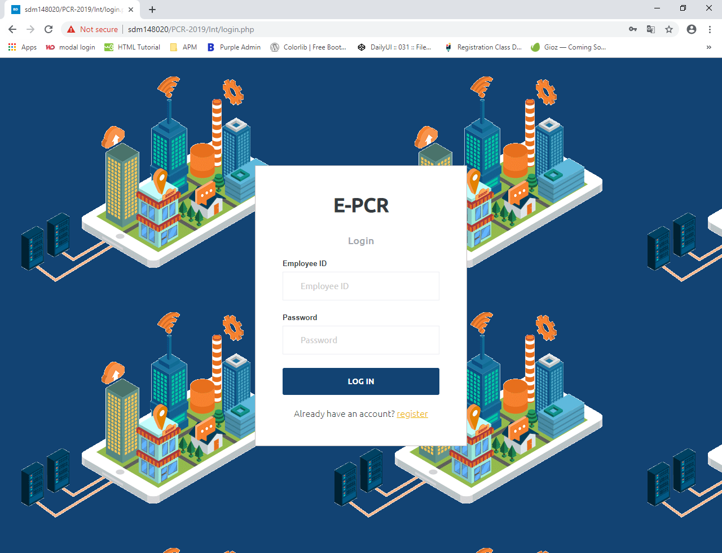
SYSTEM USER INTERFACE: PCR SYSTEM
INTERFACE:LOGIN

Slide 29
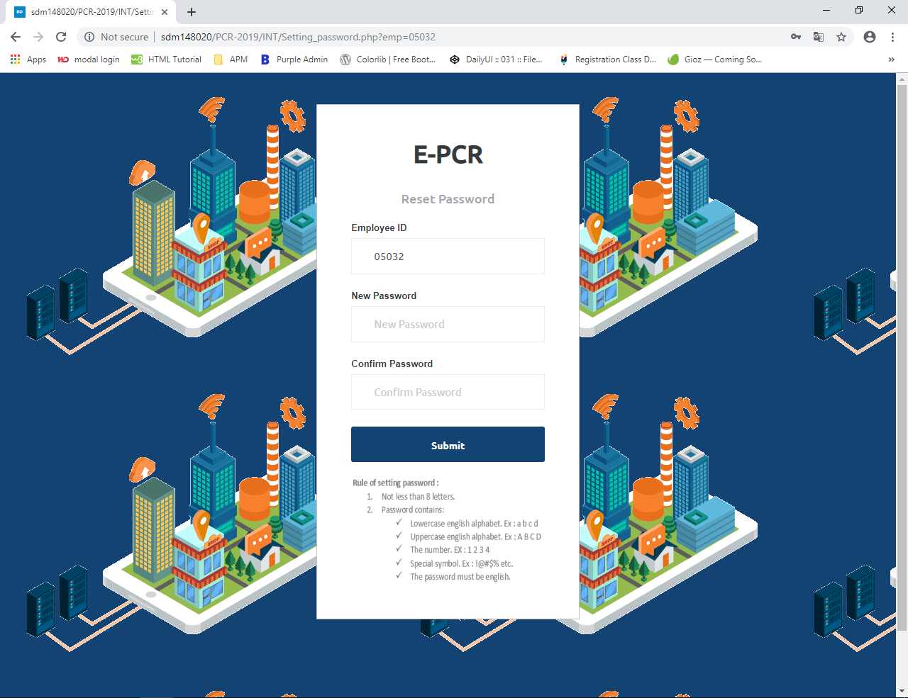
SYSTEM USER INTERFACE: PCR SYSTEM
INTERFACE:SETTING PASSWORD

Slide 30
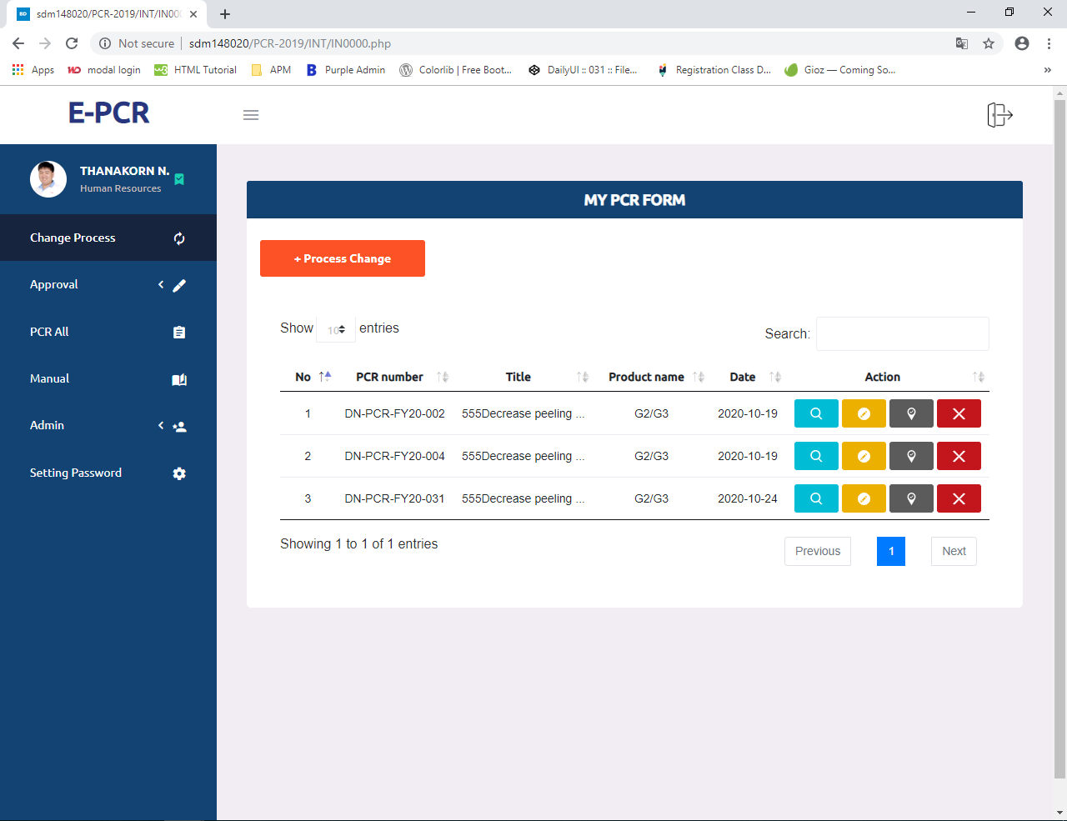
SYSTEM USER INTERFACE: PCR SYSTEM
INTERFACE:MAIN

Slide 31
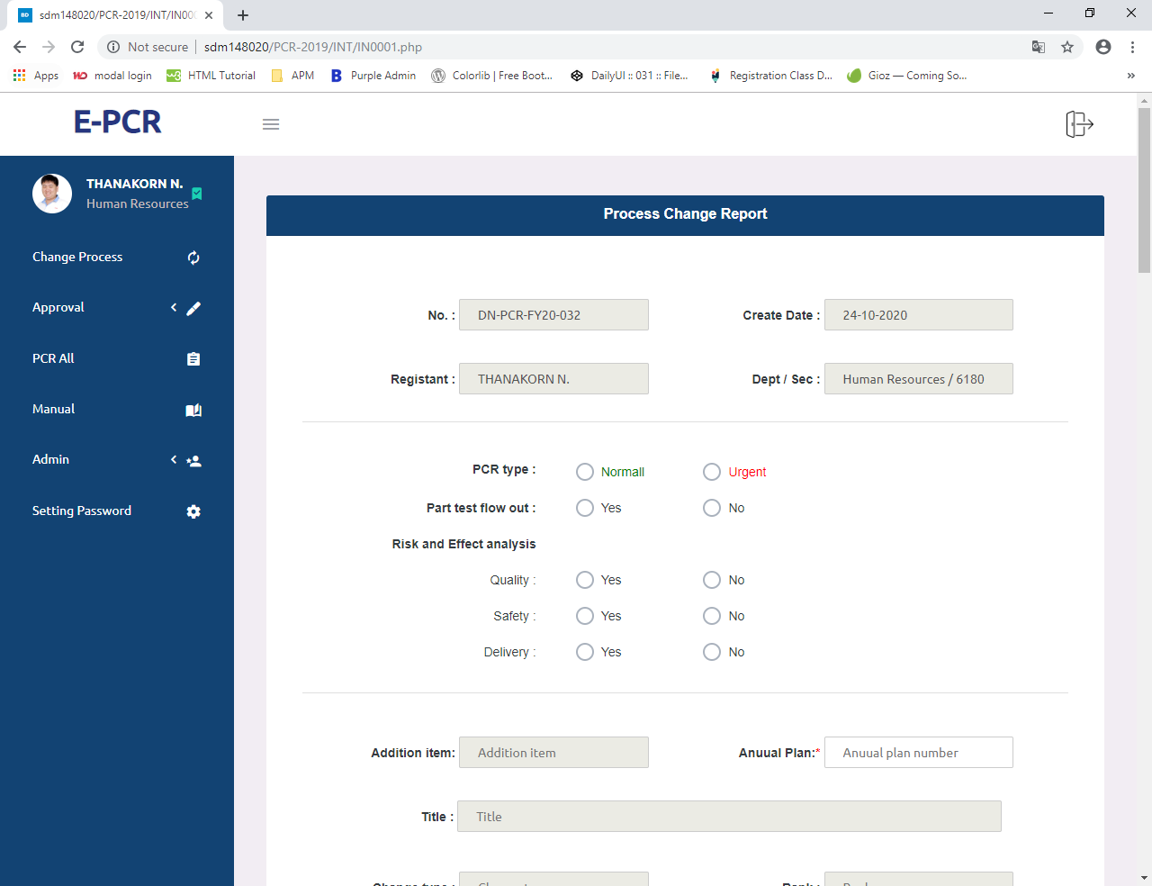
SYSTEM USER INTERFACE: PCR SYSTEM
INTERFACE:CREATE PCR FORM

Slide 32
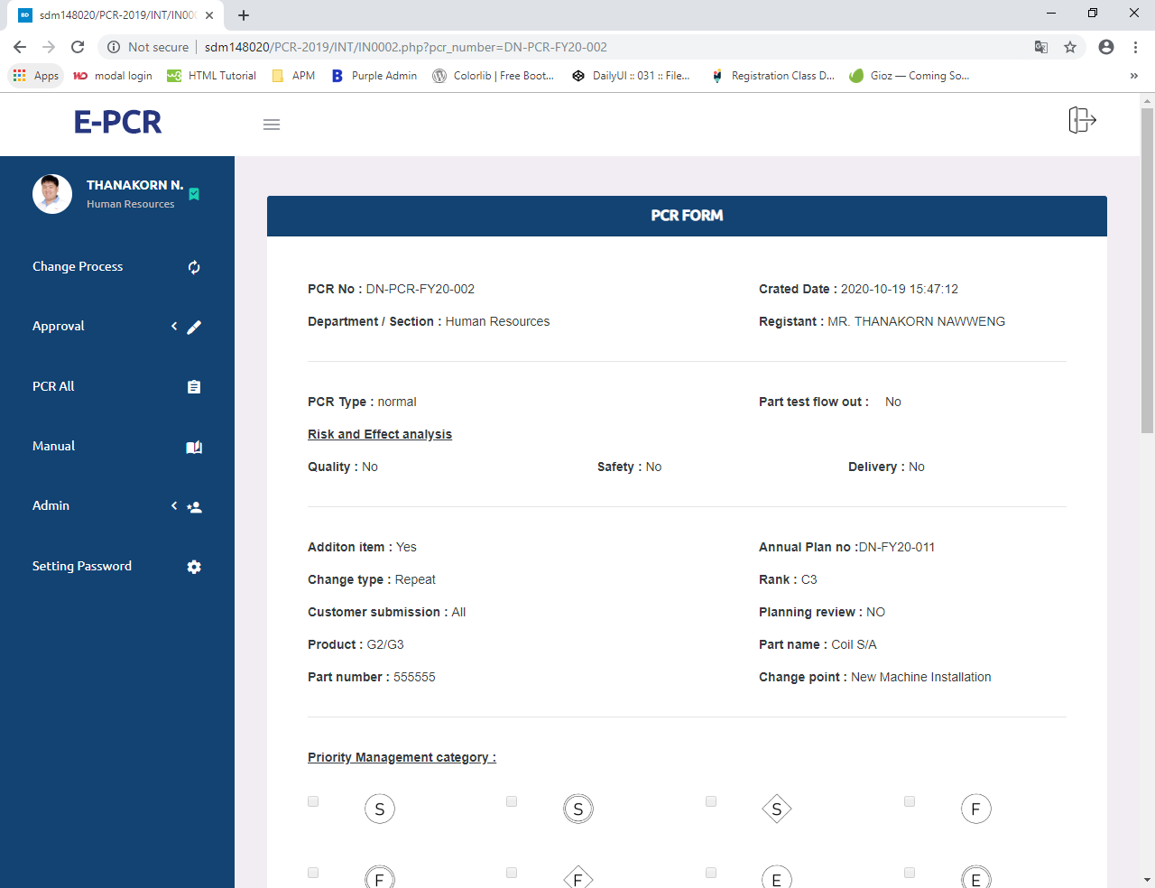
SYSTEM USER INTERFACE: PCR SYSTEM
INTERFACE:VIEW PCR FORM

Slide 33
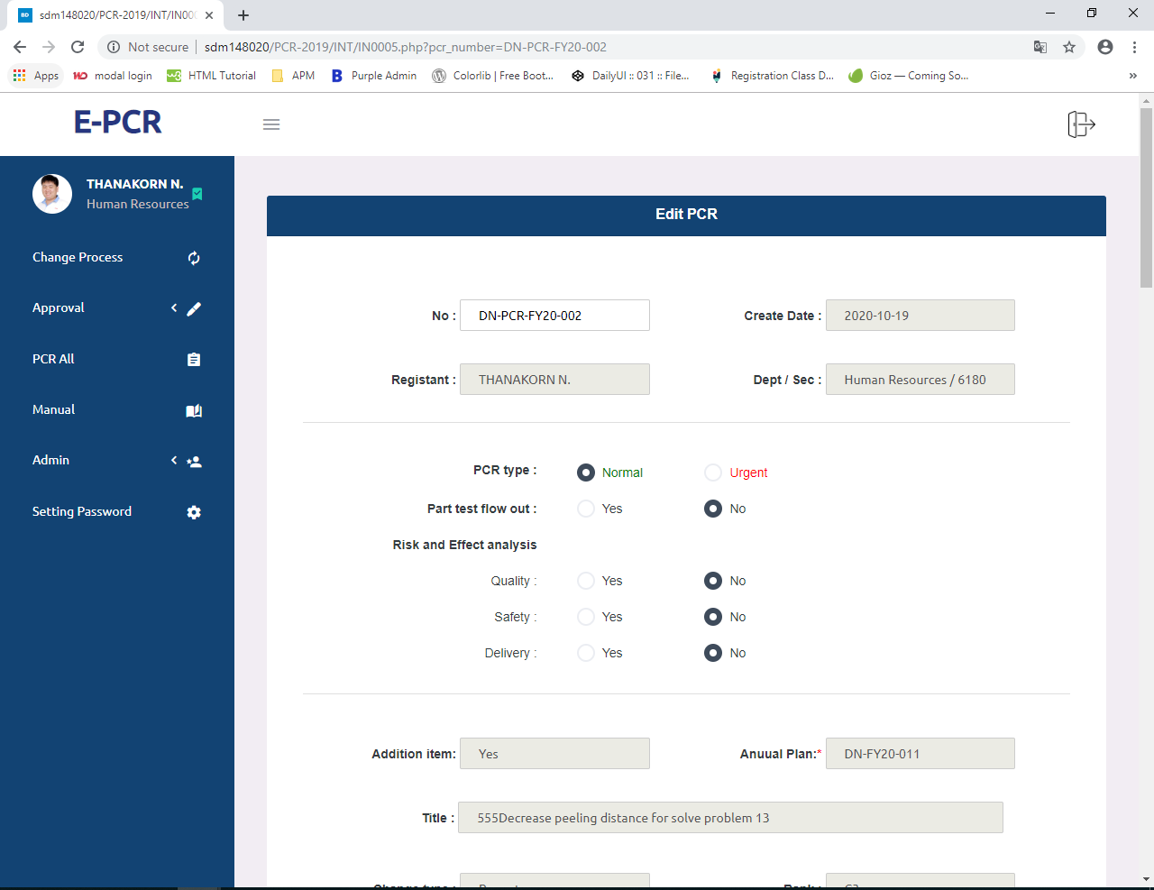
SYSTEM USER INTERFACE: PCR SYSTEM
INTERFACE:EDIT PCR FORM

Slide 34
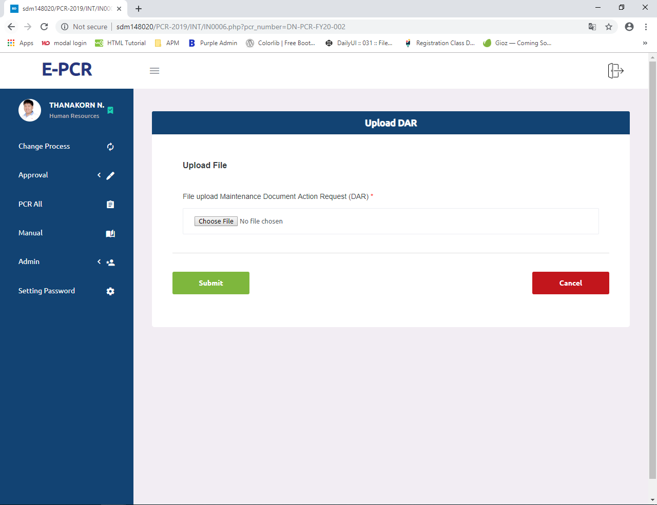
SYSTEM USER INTERFACE: PCR SYSTEM
INTERFACE:CANCEL PCR FORM

Slide 35
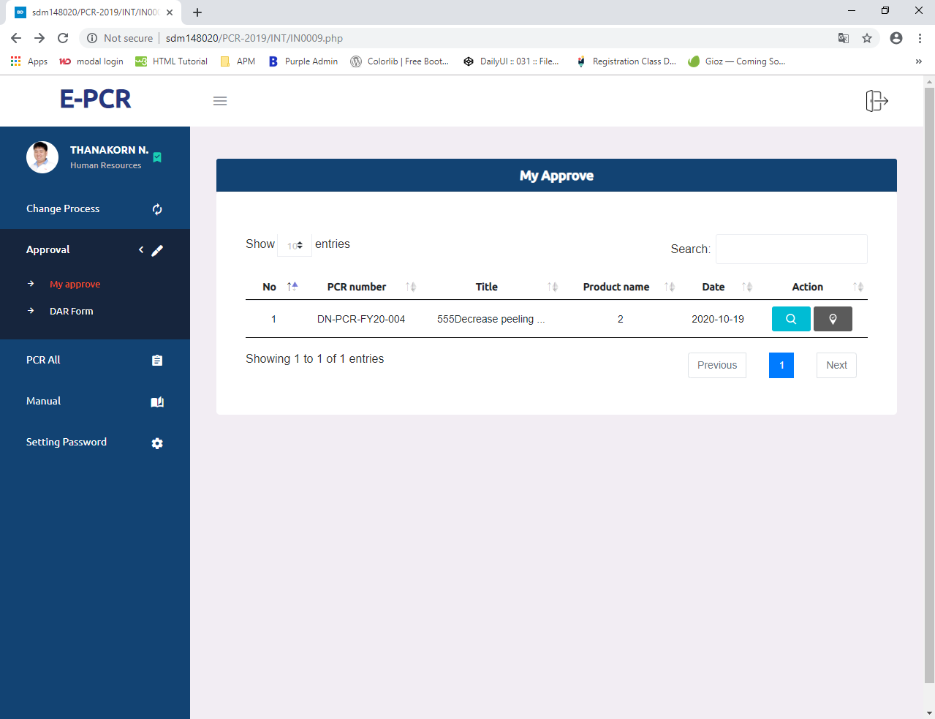
SYSTEM USER INTERFACE: PCR SYSTEM
INTERFACE:APPROVE PCR FORM

Slide 36
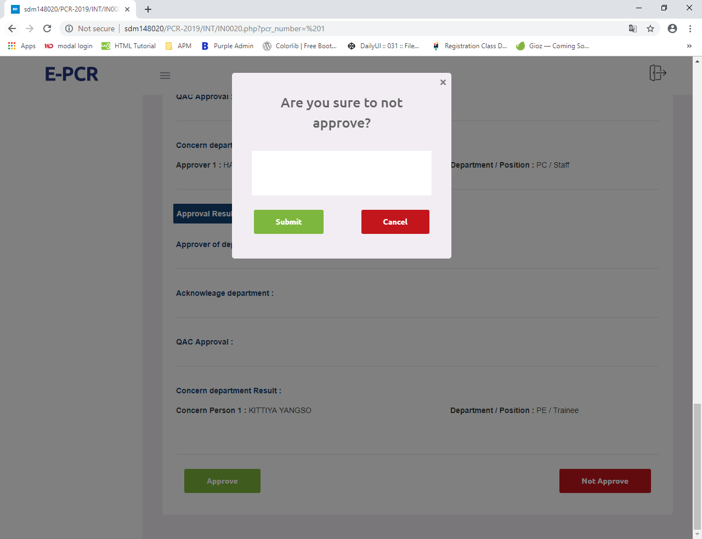
SYSTEM USER INTERFACE: PCR SYSTEM
INTERFACE:APPROVE FORM

Slide 37
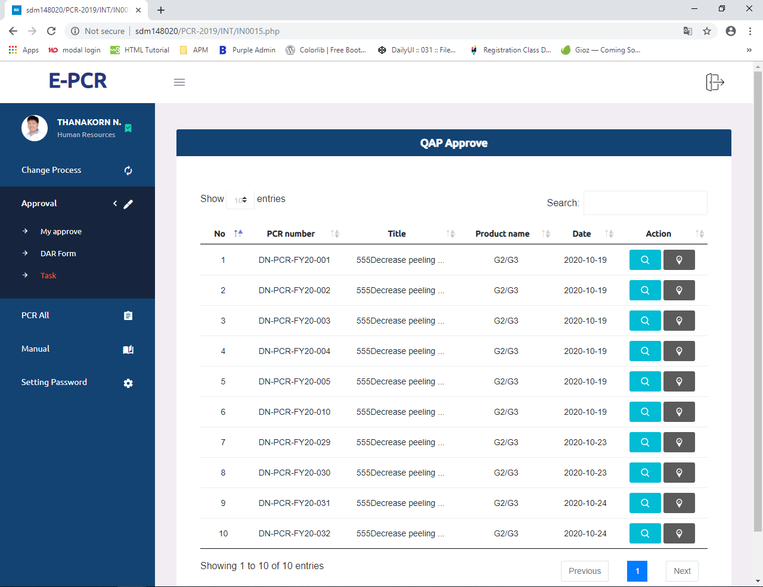
SYSTEM USER INTERFACE: PCR SYSTEM
INTERFACE:QAP APPROVE PCR FORM

Slide 38
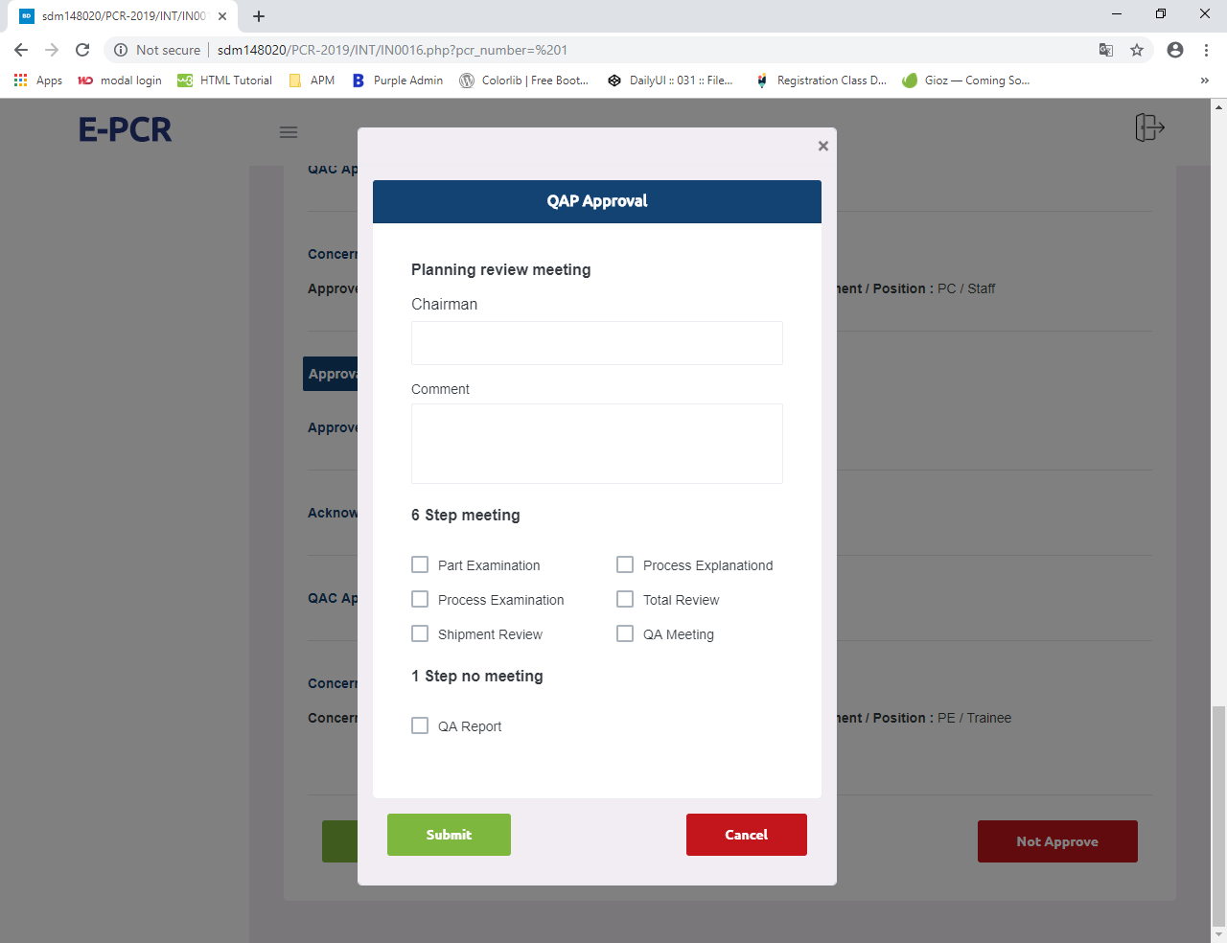
SYSTEM USER INTERFACE: PCR SYSTEM
INTERFACE:QAP FORM

Slide 39
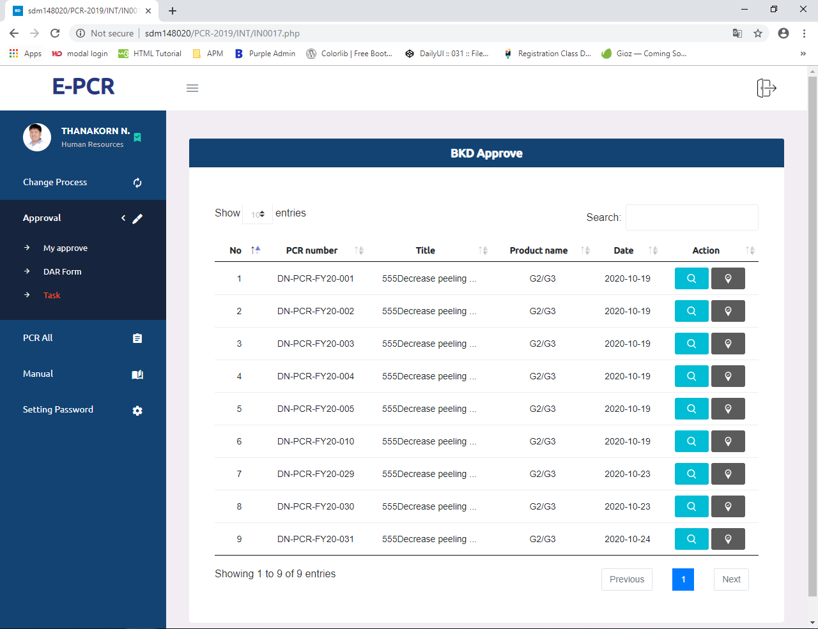
SYSTEM USER INTERFACE: PCR SYSTEM
INTERFACE:BKD APPROVE PCR FORM

Slide 40
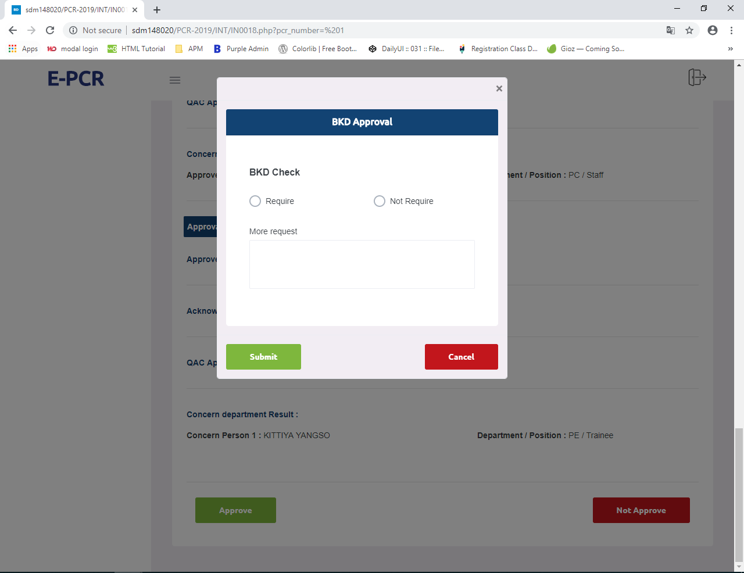
SYSTEM USER INTERFACE: PCR SYSTEM
INTERFACE:BKD FORM

Slide 41

SYSTEM USER INTERFACE: PCR SYSTEM
INTERFACE:QAC APPROVE PCR FORM

Slide 42

SYSTEM USER INTERFACE: PCR SYSTEM
INTERFACE:QAC APPROVE

Slide 43
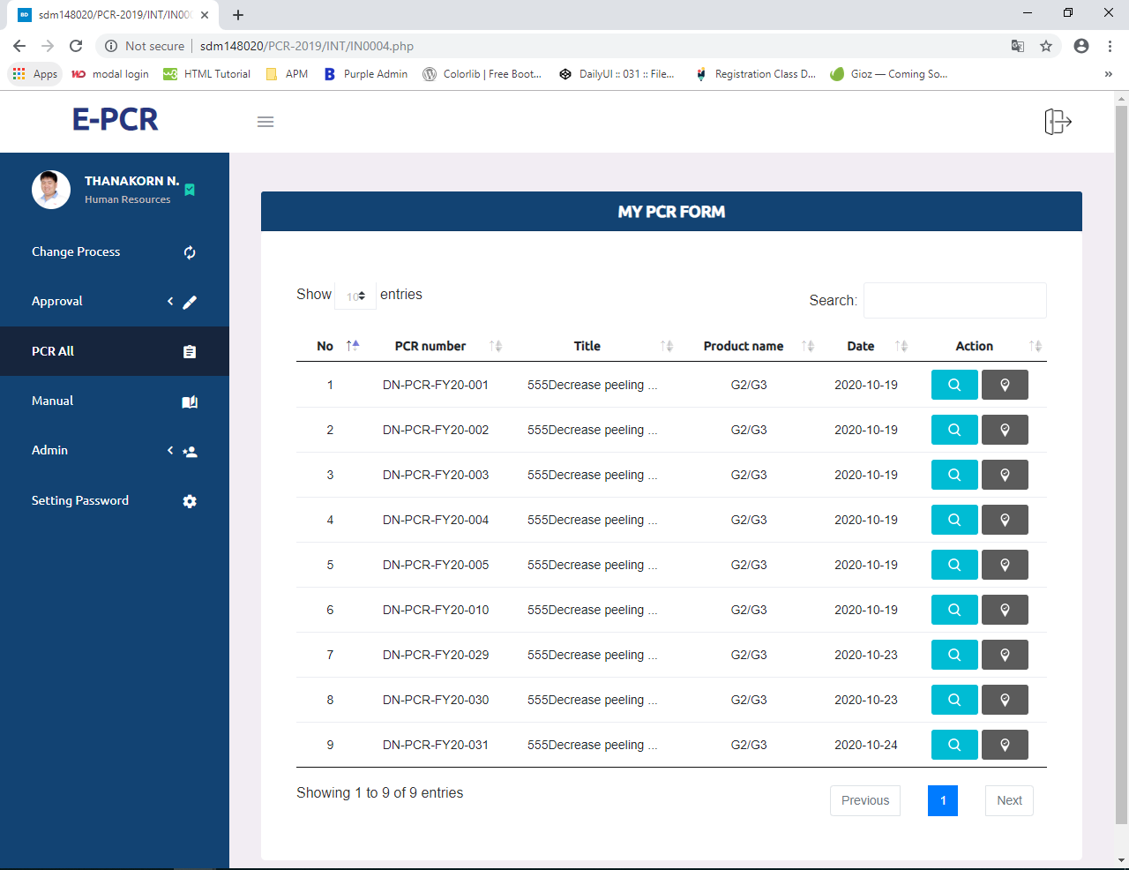
SYSTEM USER INTERFACE: PCR SYSTEM
INTERFACE:VIEW PCR ALL

Slide 44
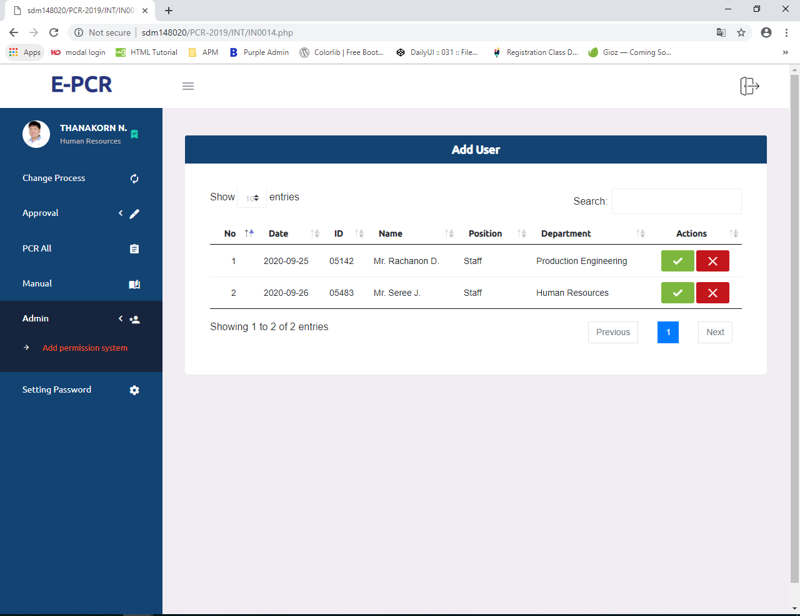
SYSTEM USER INTERFACE: PCR SYSTEM
INTERFACE:ADD PERMISSION SYSTEM

Slide 45
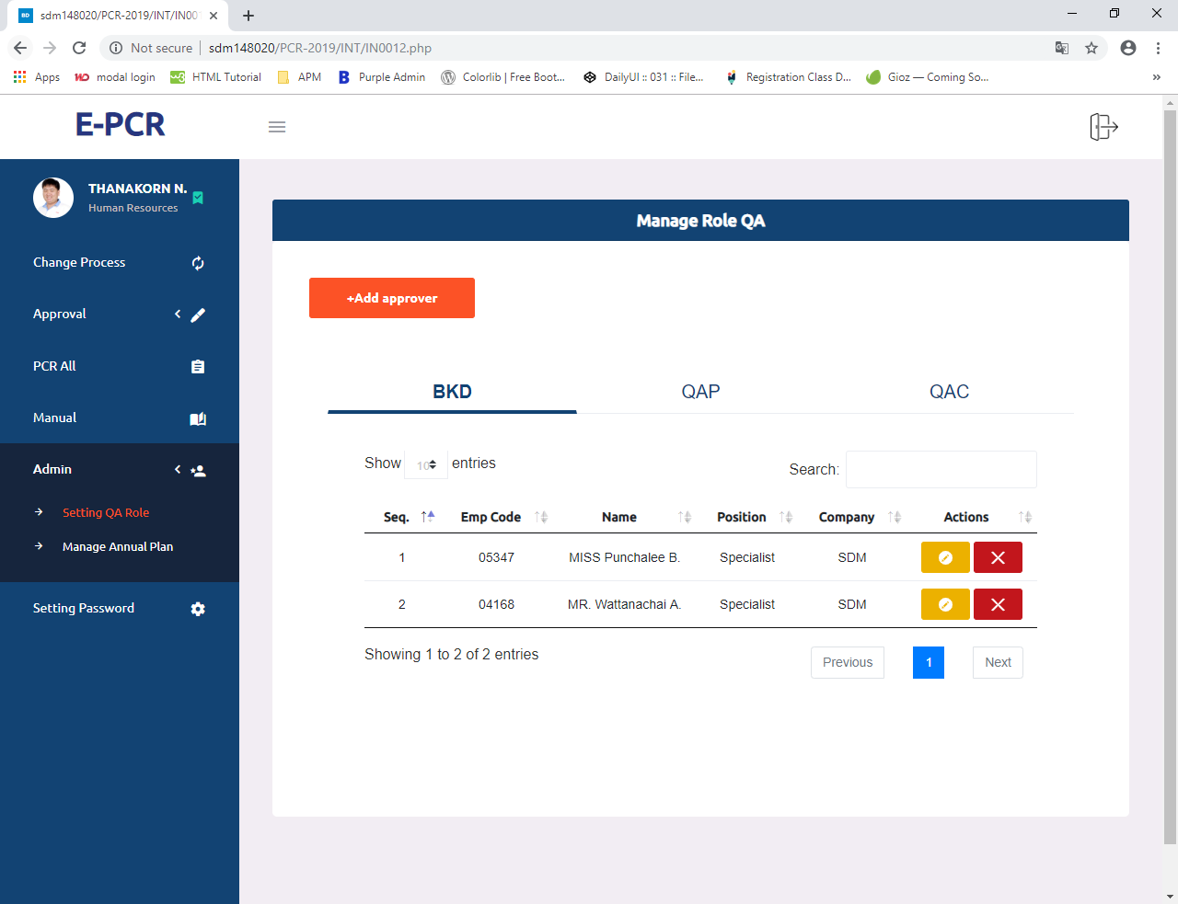
SYSTEM USER INTERFACE: PCR SYSTEM
INTERFACE:SETTING QA ROLE

Slide 46
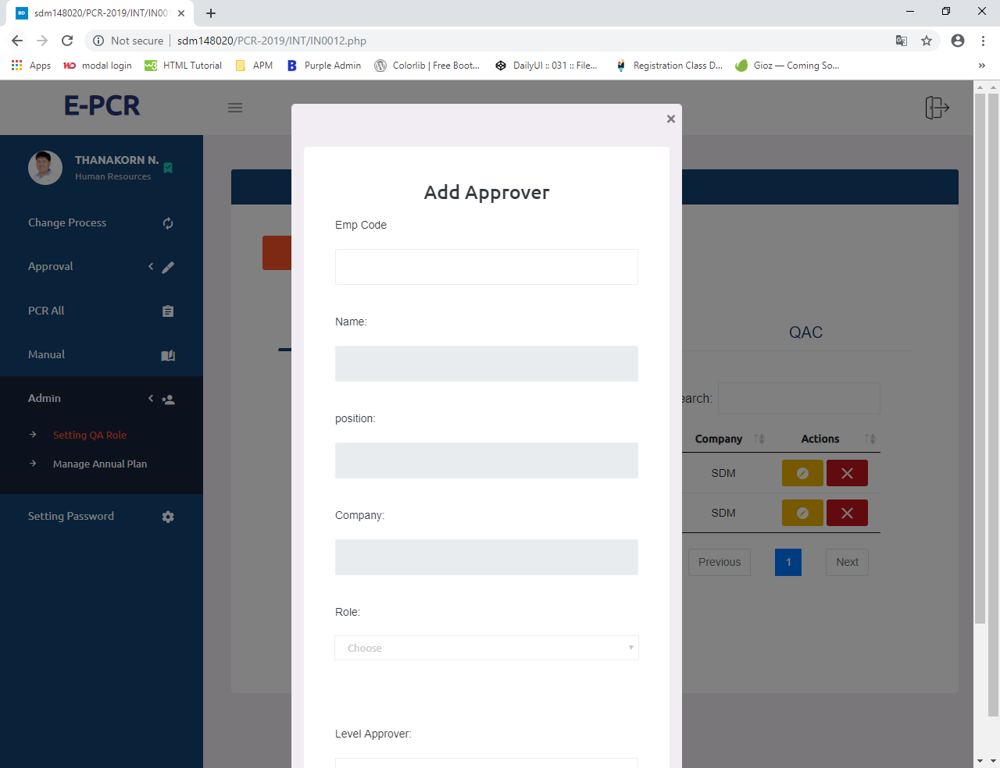
SYSTEM USER INTERFACE: PCR SYSTEM
INTERFACE:ADD QA ROLE

Slide 47
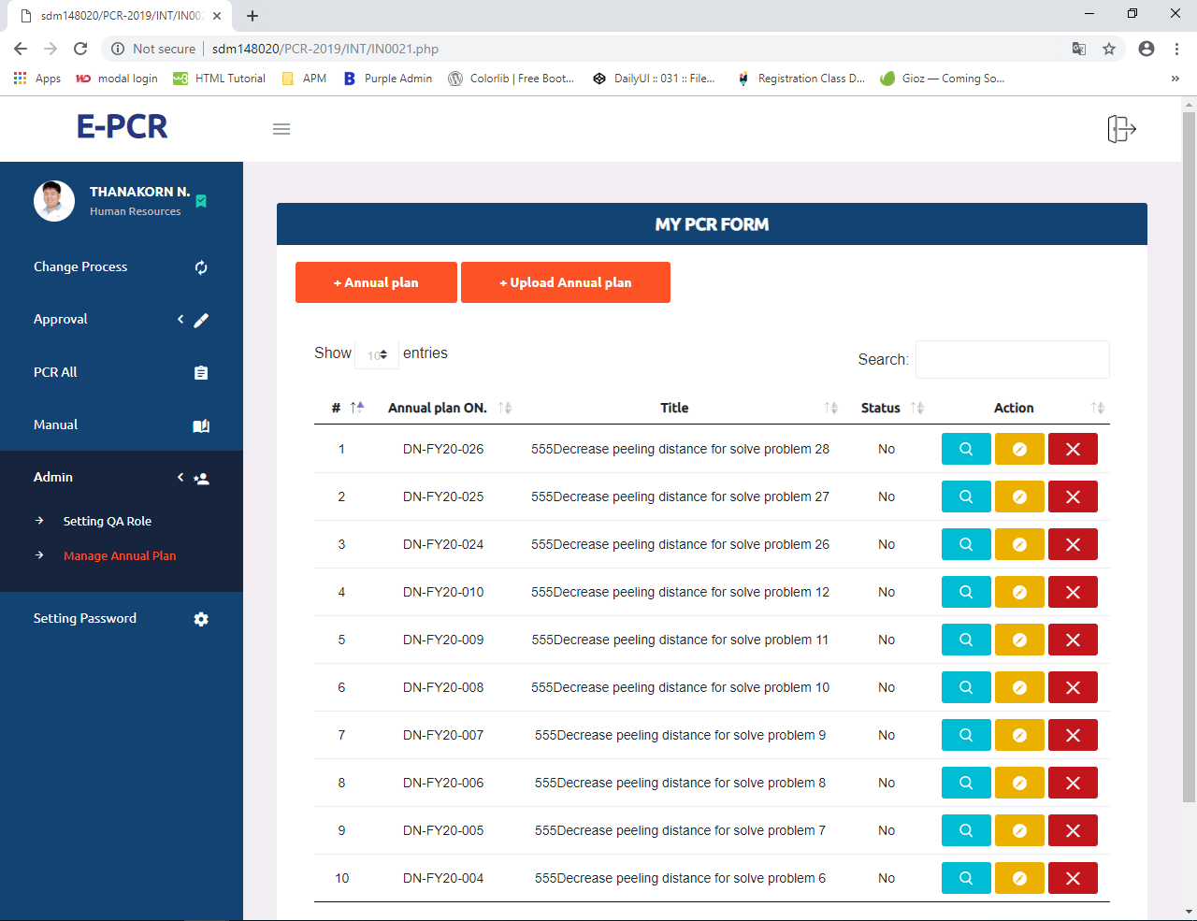
SYSTEM USER INTERFACE: PCR SYSTEM
INTERFACE:MANAGE ANNUAL PLAN

Slide 48
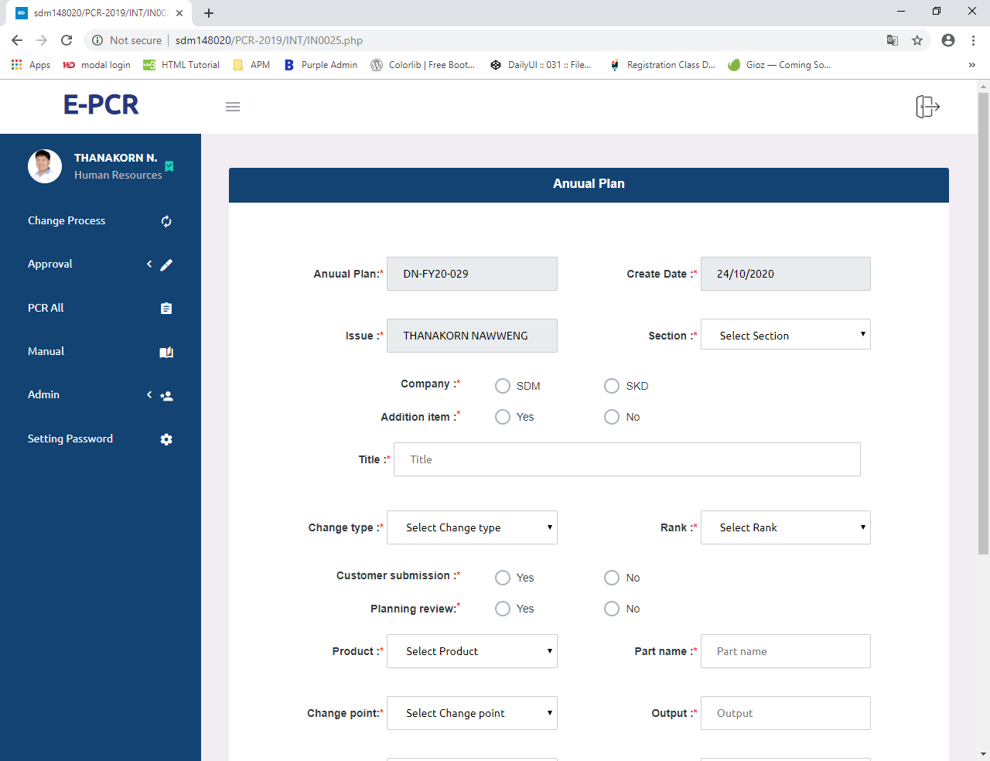
SYSTEM USER INTERFACE: PCR SYSTEM
INTERFACE:CREATE ANNUAL PLAN

Slide 49
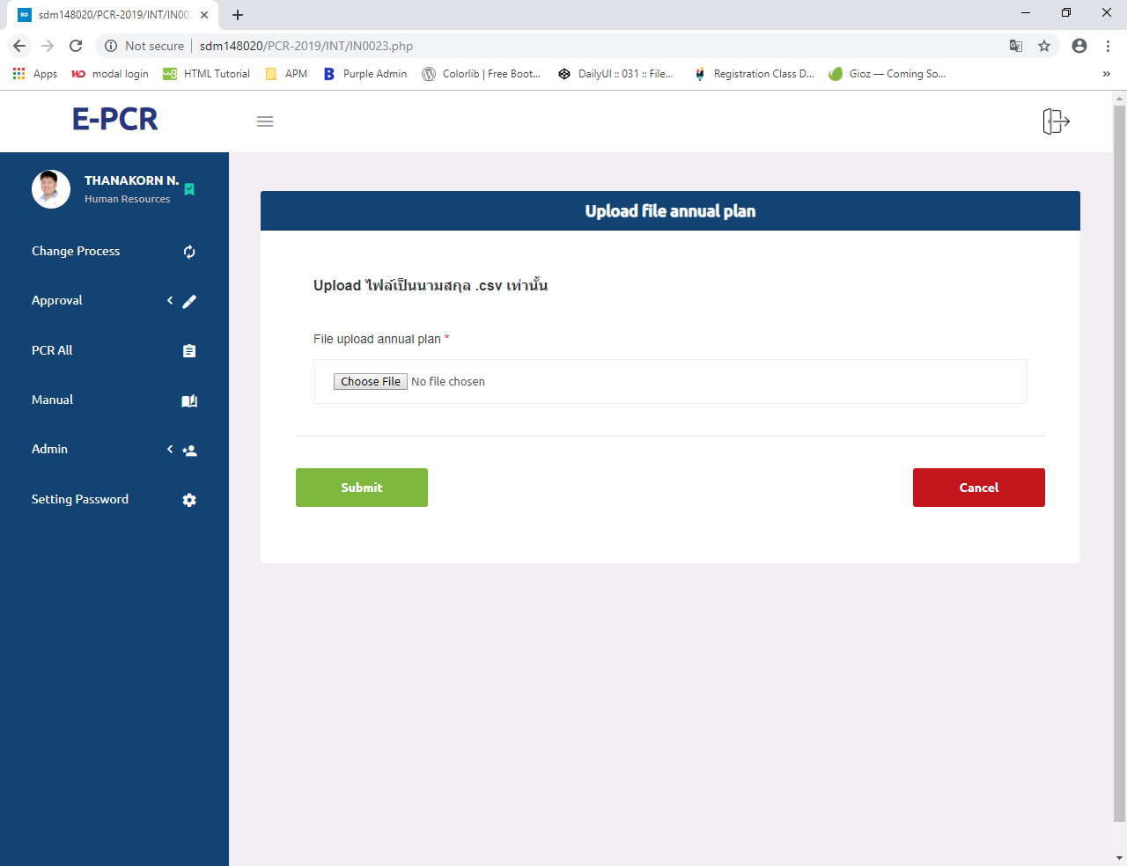
SYSTEM USER INTERFACE: PCR SYSTEM
INTERFACE:UPLOAD ANNUAL PLAN

Slide 50
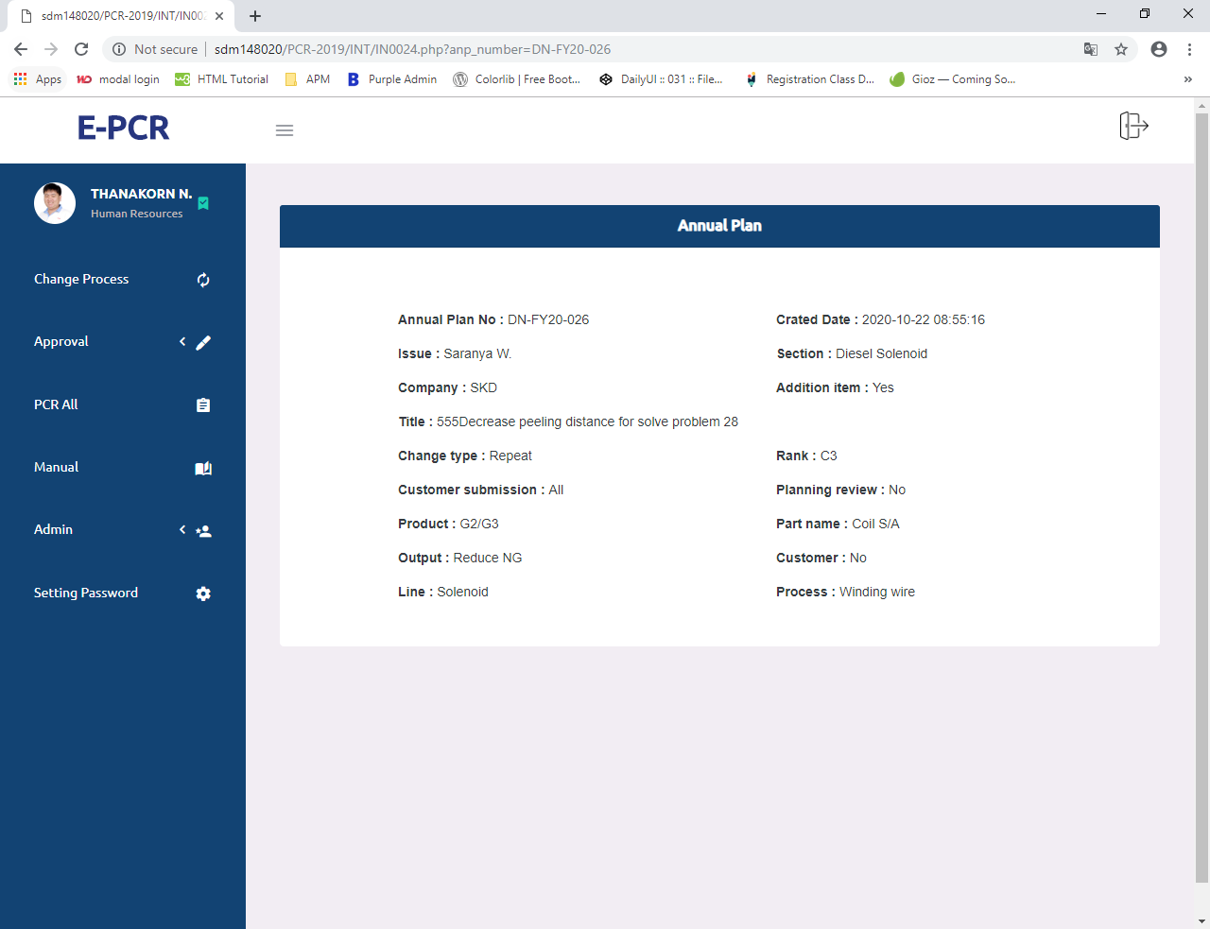
SYSTEM USER INTERFACE: PCR SYSTEM
INTERFACE:VIEW ANNUAL PLAN

Slide 51
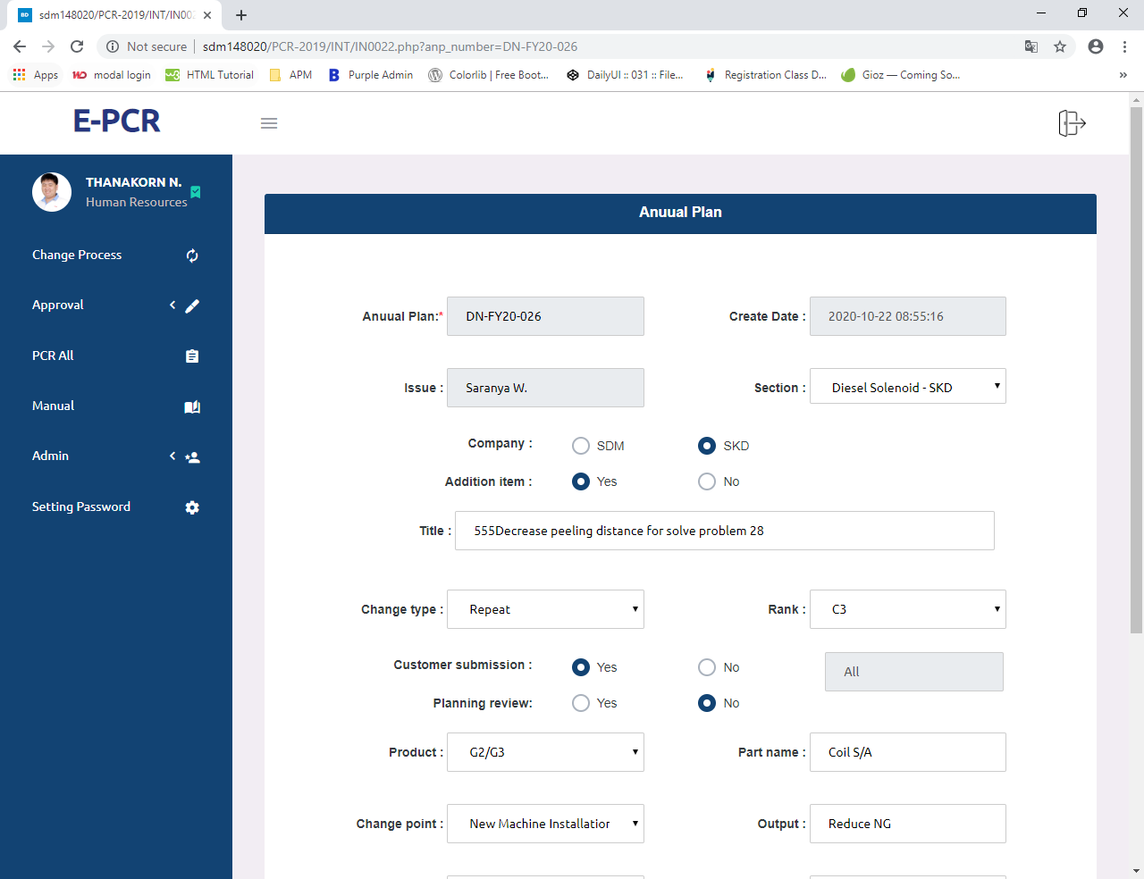
SYSTEM USER INTERFACE: PCR SYSTEM
INTERFACE:EDIT ANNUAL PLAN

Slide 52
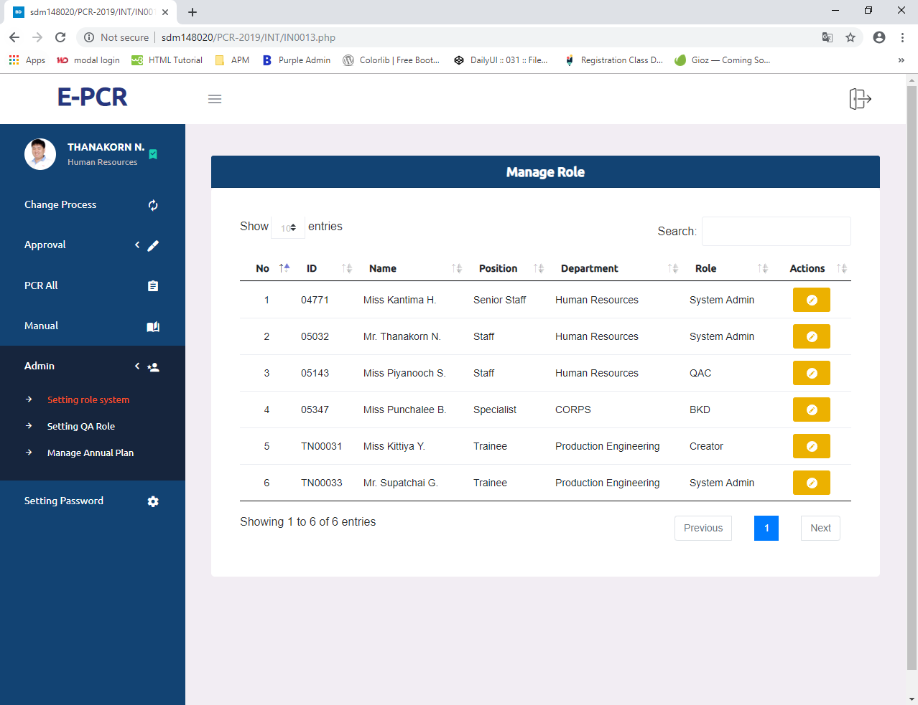
SYSTEM USER INTERFACE: PCR SYSTEM
INTERFACE:SETTING ROLE SYSTEM

Slide 53
Conclusion

Slide 54

Conclusion
1.สามารถช่วยลดปัญหาการใช้ทรัพยากรกระดาษขององค์กรให้ลดลง
4.ช่วยลดเวลาในการทำงานของกระบวนการทำงานภายในองค์กร
2.ช่วยเพิ่มศักยภาพของการทำงานภายในทีมพัฒนาซอฟต์แวร์ขององค์กรได้
3.ช่วยเพิ่มศักยภาพในการวิเคราะห์ ออกแบบและการพัฒนาระบบให้แก่ผู้ปฏิบัติงานสหกิจศึกษา

Slide 55
Skill & Experience

Slide 56

Skill & Experience
Technical Skill
Soft Skill
A:Analyze skill
B:Design skill
C:Programming skill
D:Testing skill
A:Teamwork
B:Communication
C:Problem-solving
D:Presentation skill
Kittiya Yangso
NickName : Kit

Slide 57
Skill & Experience
Technical Skill
Soft Skill
A:Analyze skill
B:Design skill
C:Programming skill
D:Testing skill
A:Teamwork
B:Communication
C:Problem-solving
D:Presentation skill
Kanyarat Rodtong
NickName : Mint

Slide 58
Skill & Experience
Technical Skill
Soft Skill
A:Analyze skill
B:Design skill
C:Programming skill
D:Testing skill
A:Teamwork
B:Communication
C:Problem-solving
D:Presentation skill
Supatchai Kamaporn
NickName : Pond

Slide 59

Thank you

Slide 60


Action Plan
Analyze System
Design
Get requirements
from user
- Analyze requirements
- Design mock up of system
Confirm mock up with user
AUG
- Design diagram
OCT
Analyze System
Implements
JUL
SEP
Analyze requirements
Confirm requirements
Coding PCR system in phase 1
Test System & Demo System
Present PCR System

Slide 61
Action Plan

Slide 62
Action Plan

Slide 63

Plan
Plan
Month
Actual
Detail
JUL
AUG
SEP
OCT
Analyze System
Design
Implements

